Slide 1
Temporal evolution of beta bursts in the parkinsonian cortical and basal ganglia network Cagnan ea., PNAS, 2019
StepUp Journal Club
15th March 2023

Slide 2
todays topic
Temporal evolution of beta bursts in the parkinsonian cortical and basal ganglia network

Slide 3

author
Location | Research Area | H-Index
Group Leader at MRC BNDU Oxford | -Neuromodulation - PD & ET | 25 Bilateral adaptive deep brain stimulation is effective in Parkinson's disease (~290)
Hayriye Cagnan

Slide 4
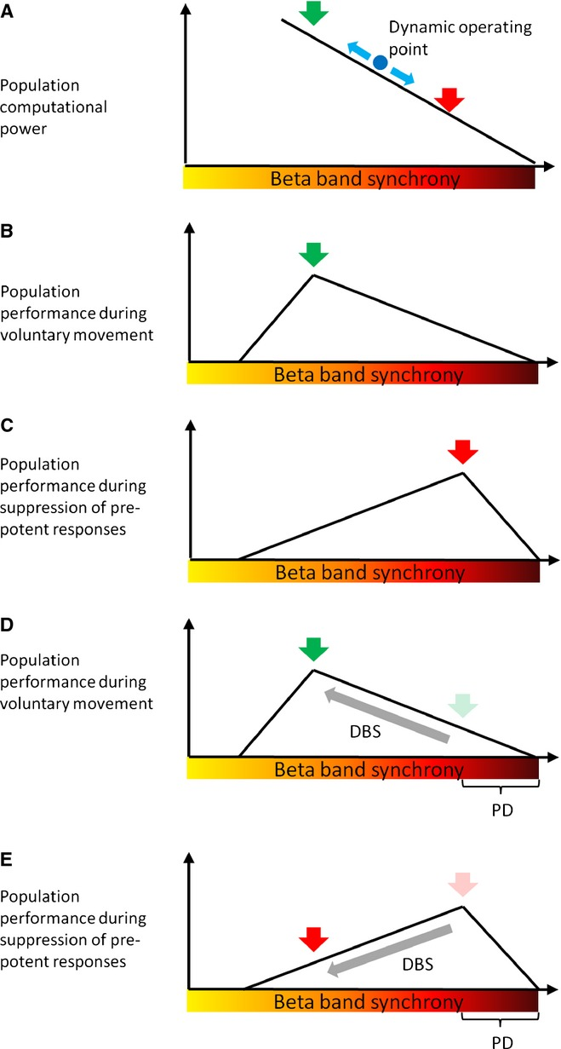
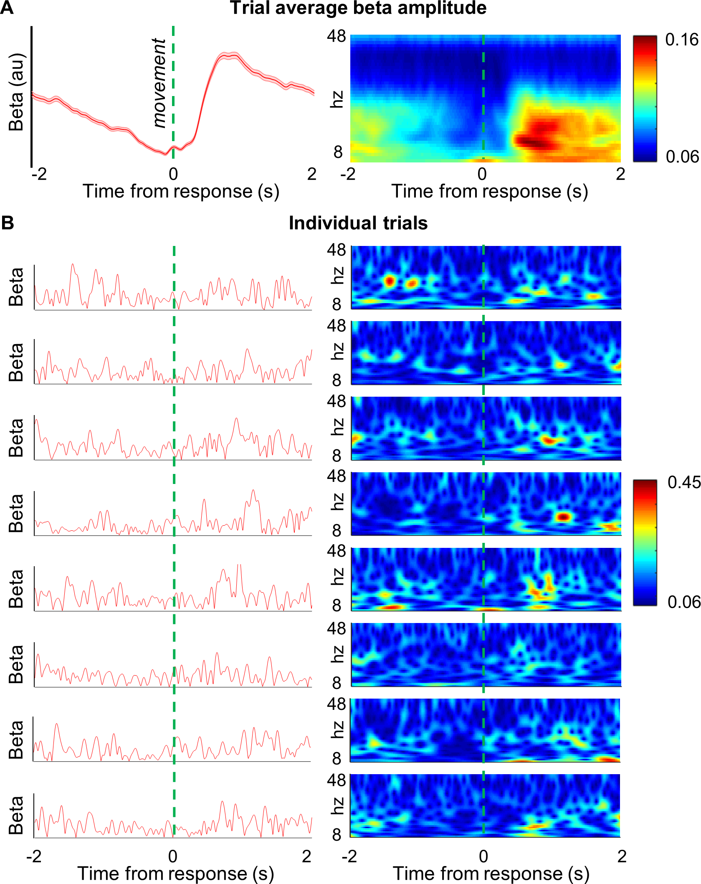
intro
Beta oscillations in cortical and basal ganglia circuits become abnormally synchronized in PD
How excessive beta oscillations emerge in these circuits is unclear
How change the firing properties of basal ganglia neurons around the emergence of cortical beta bursts
a certain motor response becomes inappropriate or has to be cancelled
a treatment that drives beta synchronization down may improve limb bradykinesia in PD
lead to impulsive action when inhibition of limb movement is more behaviourally relevant
Little ea., PLOS Biology, 2019; Brittain, EurJNeurosci, 2014
Notes:
Basal Ganglia:
Striatum (Caudate Nucleus, Putamen, Nucleus accumbens)
Globus Pallidus (internal & external) (Gpe, Gpi)
Substantia nigra
Subthalamic nucleus (STN)
„Note that if beta synchronization is to be considered as a means of gating computational power and controlling the balance between history (status quo) and reactivity, then increases should be graded and not binary, and there is evidence for this at both cortical (Spinks et al., 2008) and subcortical (Tan et al., 2013) level“ (Brittain et al., 2014, p. 1953)
Figure 1
Schematic relationship between beta band synchrony, computational power and population performance. (A) Dependency of computational power on the level of beta band synchrony. (B) Voluntary response. (C) Suppression of prepotent response. (D) Effect of DBS when elevated synchronization is task inappropriate, as when voluntary movement has to be made. Suppression of beta synchronization leads to less impaired movement. (E) Effect of DBS when elevated synchronization is task appropriate, as in the suppression of a prepotent response. Suppression of beta synchronization leads to impulsive action. Population performance is with respect to optimal behaviour for the given context. Green and red arrows denote task and context-optimal population performance in each case. DBS, deep brain stimulation; PD, Parkinson's disease.
These pathological beta oscillations are suppressed when continuous high-frequency deep brain stimulation (DBS) is applied to either subthalamic nucleus (STN) or the internal segment of the globus pallidus (57), suggesting a strong dependence on a distributed subcortical network architecture for their generation and maintenance
Fig 2. Single trial beta events do not match the dynamicsof trial-averaged beta activity. (A) Time series of trial-averaged contralateral M1 beta amplitude (13–30 Hz; subject 2; block 1; mean ± SEM 535 trials; left panel). This shows classical ERD and ERS in the pre- and post-movement periods, respectively. Trial-average time-frequency amplitude spectrogram (same subject; wavelet decomposition; see Materials and methods; right panel) showing areduction in spectral activity specific to the beta band in the period prior to movement, followed by an increase following movement. (B) Individual trial data from the same subject (no. 2;run 3;trials 250–258) as the beta amplitude envelope (red; left panels) and as time-frequency amplitude spectrograms(right panels). At the single trial level, beta amplitude does not closely resemble the trial average but appears highly dynamic with short lasting bursts, which are more common around the time of the average ERS. The underlying data can be found in the post-processed file

Slide 5
theories on abnormal propagation
the excitatory–inhibitory coupling between the STN and the external segment of the globus pallidus (GPe)
alteration of striatal output, possibly due to interneuron dysfunction
enhanced pallidostriatal positive feedback
Based on stable oscillations, but:
“[…] cortical and basal ganglia phase locking occurs predominantly during […] beta bursts.”

Slide 6
research question:
“[…] how beta oscillations are propagated and amplified can potentially be approached by identifying the neuronal interactions that occur before, during, and after these transient events. “

Slide 7
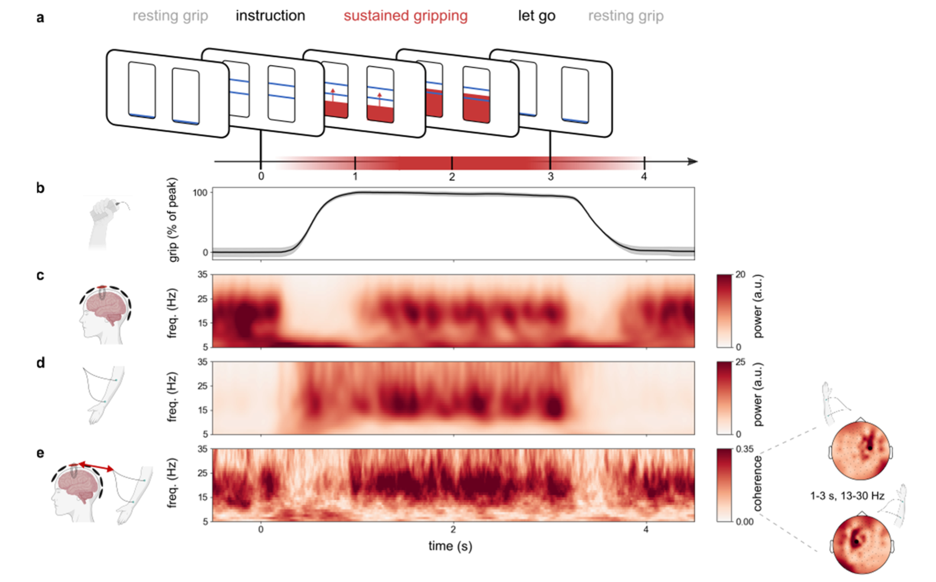
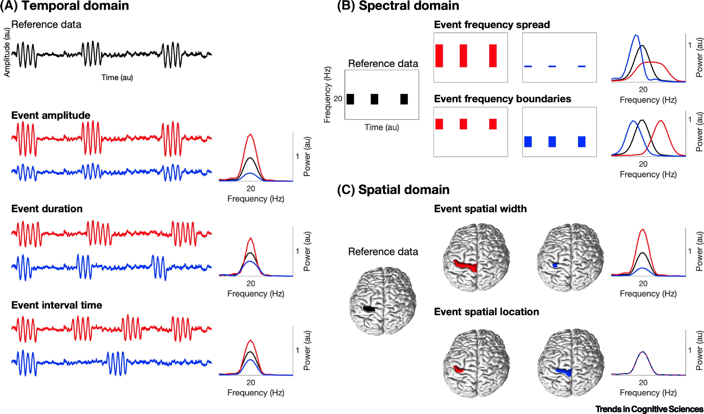
what are beta bursts?
Echeverria-Altuna, Progress in Neurobiology, 2022; Zich, Trends CogSci, 2020

Slide 8
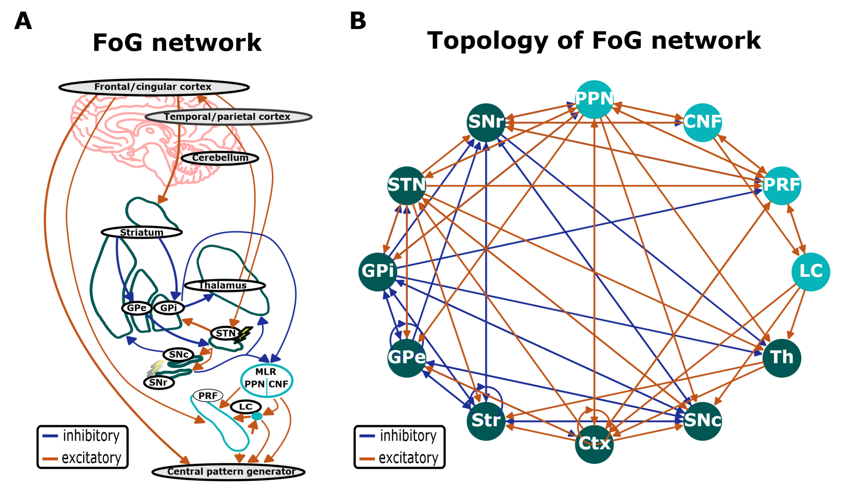
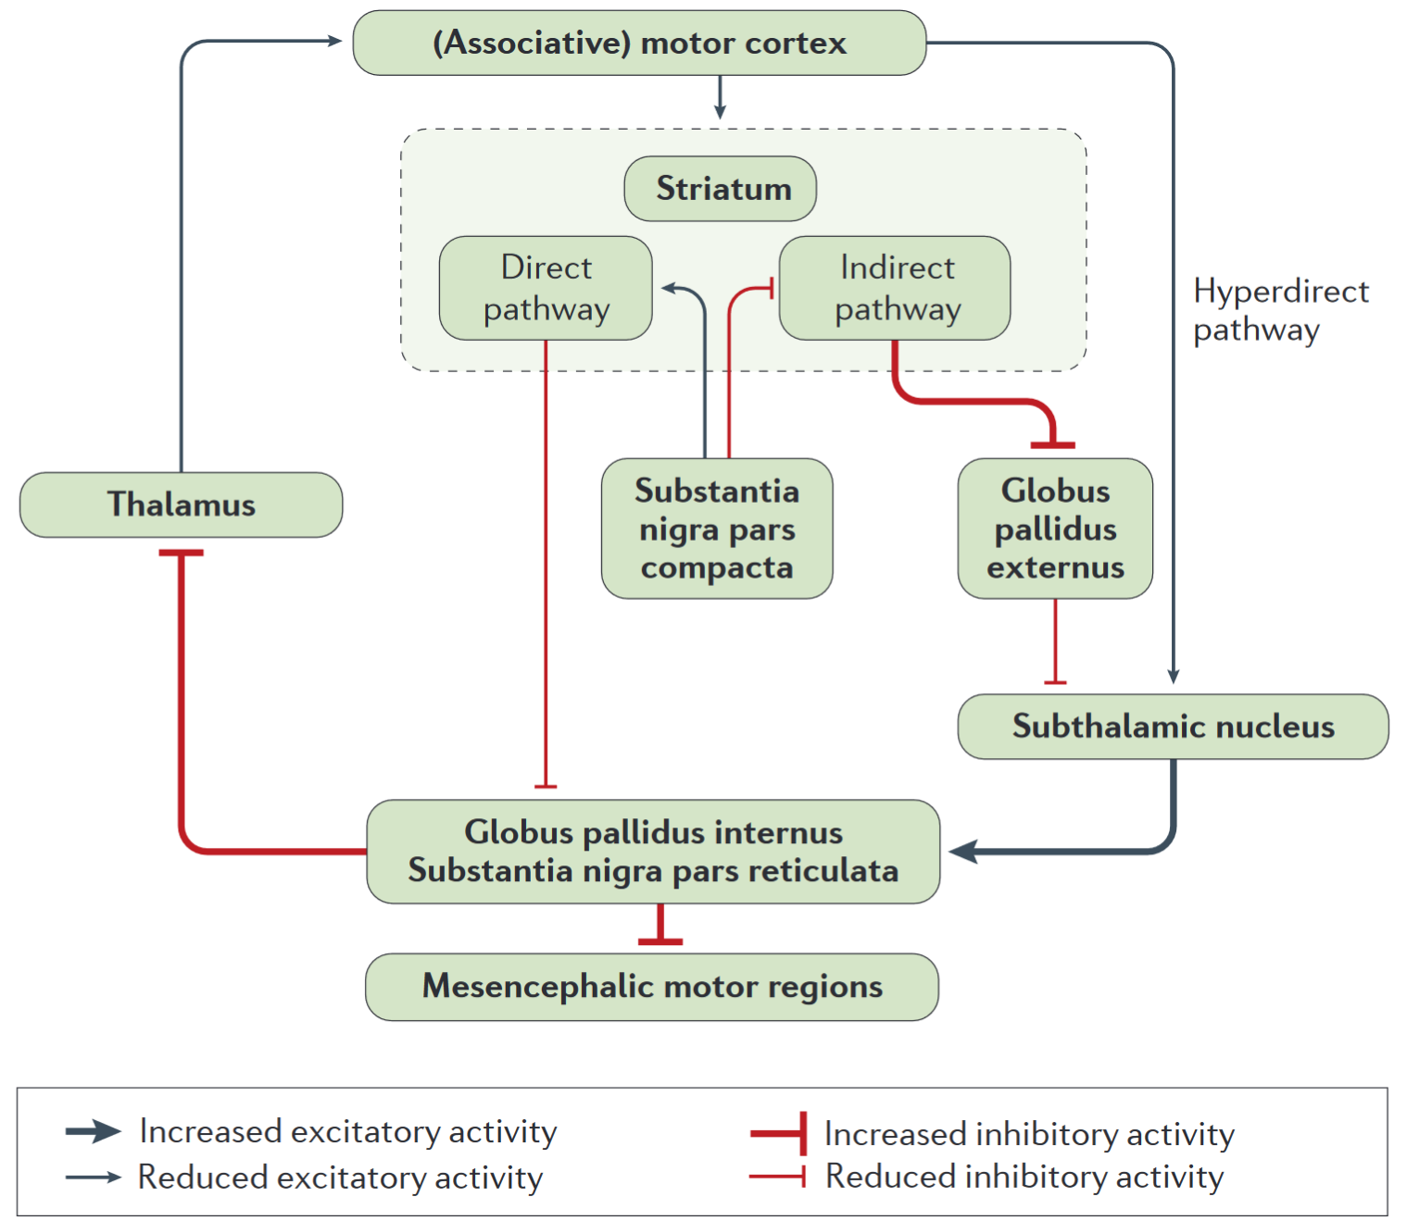
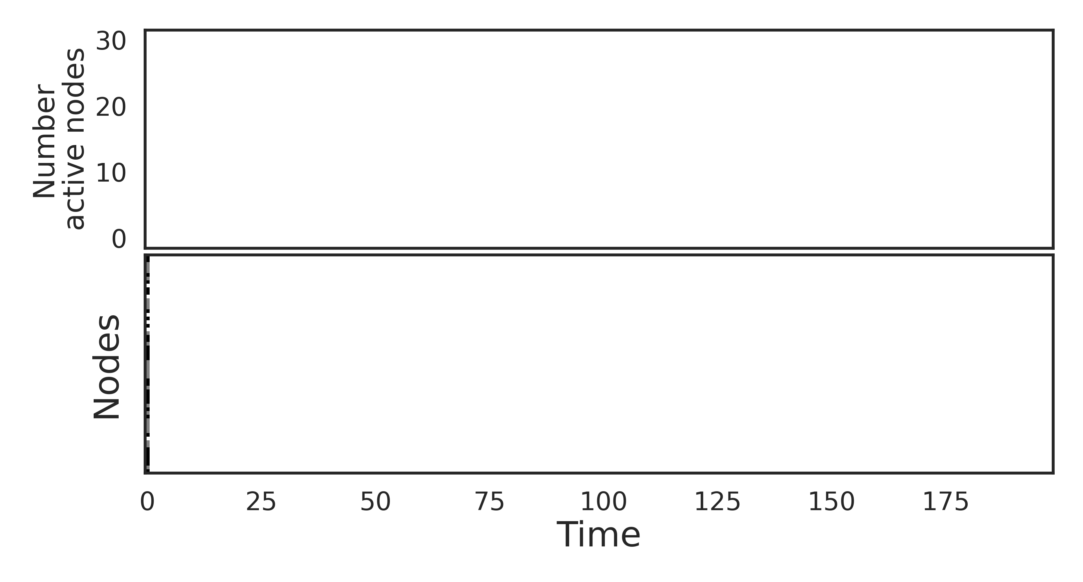
why?
Poewe, Nature Reviews, 2017; Popova, bioRxiv, 2023
Notes:
Figure 4 | Motor cortex circuitry activity changes in Parkinson disease. The motor circuit consists of corticostriatal projections from the primary motor cortex, supplementary motor area, cingulate motor cortex and premotor cortex, terminating on dendrites of striatal medium spiny neurons. The hyperdirect pathway has direct glutamatergic connectivity from the motor cortex to the subthalamic nucleus. The globus pallidus internus and the substantia nigra pars reticulata are the two main output nuclei of the basal ganglia and project to the brainstem and ventrolateral thalamus. The striatal projections to these output nuclei are divided into ‘direct’ and ‘indirect’ pathways. The direct pathway is a monosynaptic connection between medium spiny neurons that express dopamine D1 receptors and GABAergic neurons in the globus pallidus internus and the substantia nigra pars reticulata. The ‘indirect’ pathway originates from medium spiny neurons that express D2 receptors, which project to the globus pallidus externus, and reaches the globus pallidus internus via the subthalamic nucleus as a glutamatergic relay. Through these two pathways, the striatal dopaminergic tone regulates the GABAergic output activity of the basal ganglia. As indicated, parkinsonism is associated with changes in these relays. Indeed, nigrostriatal dopamine deficiency has opposing effects on the direct and indirect pathways. Although D1-mediated direct pathway activity becomes reduced, D2-mediated indirect pathway activity increases, resulting in the net effect of a strong increase in the firing rate of GABAergic basal ganglia output neurons, w
Fig 2. FoG network schematics. A Simplified schematic of the signal flow involved in gait generation and posture control. Lightning symbols indicate potential DBS targets. B Graph representation of the FoG network. Inhibitory and excitatory synaptic connections are shown as blue and red arrows, respectively. The basal ganglia regions are shown in green, whereas the brainstem regions are in turquoise. Abbreviations: Ctx - cortex, SNc - substantia nigra pars compacta, striatum, GPi globus pallidus pars interna, GPe - globus pallidus pars externa, STN - subthalamic nucleus, Th - thalamus, SNr - substantia nigra pars reticulata, MLR - mesencephalic locomotor region, PPN - pedunculopontine nucleus, PRF - pontine reticular formation, CNF - cuneiform nucleus, LC - locus coeruleus.

Slide 9
methods
EEGs (Fz and Cz) and intraoperative STN recordings from 7 PD patients
89 LFPs (Str, STN GP) and ECoG (frontal, motor cortex) from 7 parkinsonian rats (6-OHDA lesioned)
Beta (15-35Hz) down sampled at 512 Hz FFT based power
Phase synchrony index (PSI) in time and bursts as outcomes

Slide 10
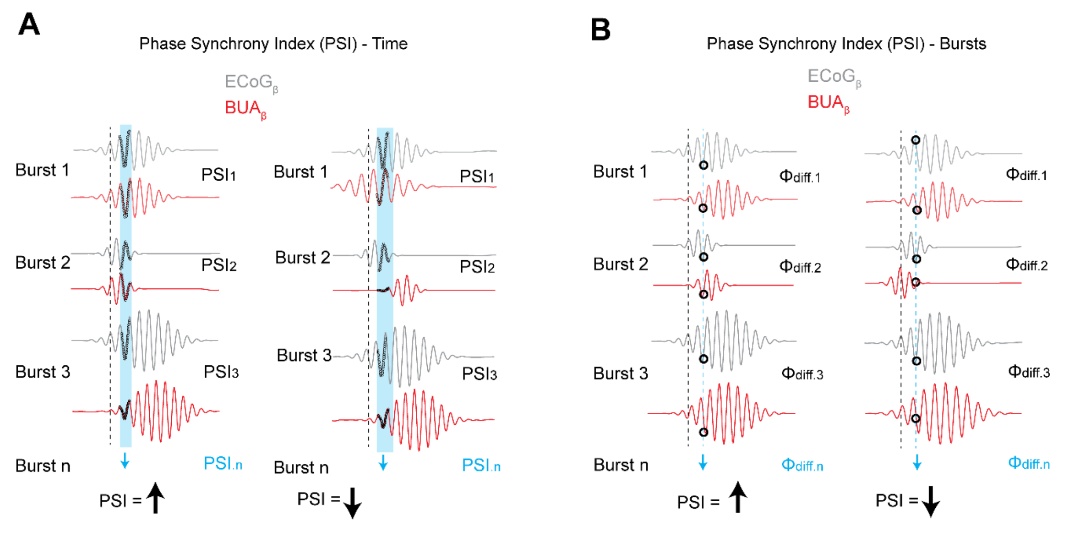
outcome parameters
| PSI
If both across time and across burst measures increase at a given point in time/window (in relation to the burst threshold), synchronization is increased in individual bursts, and the phase relationship (conditions of synchronization) is consistent
Notes:
Figure S1. Schematic examples of methods of analyzing phase-locking between the EEG/ECoG and background unit activity (BUA). To analyze phase-locking between ECoG and BUA, both signals were first filtered in the beta frequency band, and the phase of these signals was extracted using the Hilbert transform (denoted by ECoGβ and BUAβ, this example would be the same for the EEGβ in the human data). These filtered signals are represented by idealized sine waves in both plots. Pairs of ECoGβ and BUAβ signals were then analyzed using two variations of the phase synchrony index (PSI), which essentially measures the consistency (vector length) of the difference between series of phases (for details of calculation, see methods). The figure is a purely schematic representation of the factors that contribute to different outcomes of PSI analyses. A) PSI calculated over time. The PSI is calculated from the all the data points in a 50ms window (blue bar, data points within represented by open circles) at given time in relation to the burst threshold (black dotted line) for each burst individually. These PSI values for each burst are then averaged to give a mean PSI value for each time window. High mean values thus result from high synchronization in that time window in each individual burst, irrespective of whether the phase difference changes (e.g. due to changes in frequency and/or polarity in both signals) between bursts (left). Low mean values can be the result of differences in frequency and/or alignment of periods of high signal-to-noise between signals in each individual burst. B) PSI calculated over bursts. The phase difference is calculated at one time point for each burst (black open circles). The vector length of those phase differences, for each point across bursts (corresponding to the point plotted on the x-axis), is used to calculate the PSI. Inconsistency of phase differences, which can be due to the two signals having different frequencies and/or polarities across bursts, results in a low PSI for that time point (right). The measure therefore indicates the consistency of phase difference between two signals at a given time point in relation to the burst threshold, across different bursts. If both across time and across burst measures increase at a given point in time/window (in relation to the burst threshold), synchronization is increased in indiv

Slide 11

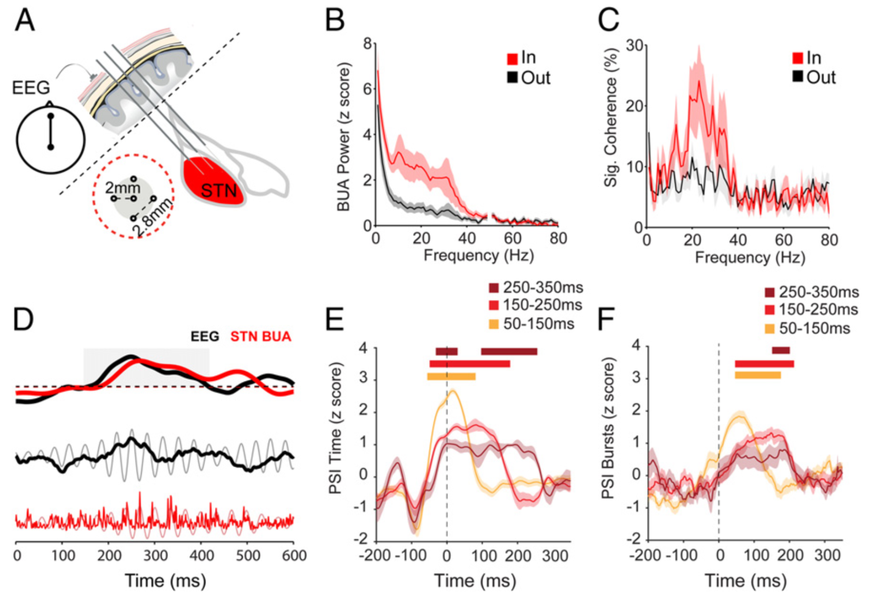
Notes:
Fig. 1. EEG β bursts are phase locked to spiking activity in the STN of PD patients. (A) BUA signals were recorded from 5 microelectrodes in the STN area together with EEG from the Fz–Cz position. As the microelectrodes traversed the STN, some electrodes were inside and some outside the structure. The layout of the 5 electrodes is shown within the red dotted circle. (B) Average BUA power spectrum from inside (red; n = 256 BUAs) and outside (gray; n = 222 BUAs) the STN, highlighting that enhanced rhythmic activity in the beta band (15 to 35 Hz) is observed inside the STN. (C) The proportion of BUA signals that are coherent with the EEG is selectively increased in the beta frequency range when electrodes were inside but not outside of the STN (number of recordings as in B). (D) An exemplary EEG β burst (black) from subject 1 (right hemisphere), together with simultaneously recorded STN-BUA (red). Onset of a cortical β burst was defined as the time point that the instantaneous beta amplitude exceeded the 75th percentile of the amplitude of the whole recording and remained elevated for at least 50 ms. Dashed line indicates the amplitude threshold for determining the onset of the EEG β burst. The beta amplitude of both the EEG and STN BUA simultaneously crosses the burst threshold and remains above it for around 200 ms (gray box). This increase in amplitude is visible in the raw (black) and filtered (gray) EEG signal. Bursts of activity in the STN BUA (raw, red; beta filtered, pink) are clearly aligned to the trough of the EEG betaoscillation during the burst. (E and F) Phase locking in time (E) and across bursts (F) around the onset of EEG β bursts (time 0; dotted line) between EEGβ and subthalamic BUAβ for different cortical β-burst durations (hemispheres = 13, patients = 7, n = 18 recordings; see color key for burst duration; see SI Appendix, Fig. S1, for schematic explanation of analysis methods). Significance for each burst length was determined using a cluster-based analysis (Methods) which tested the difference in the modulation of PSI over time in the burst-aligned data to that from randomly selected data that had no relationship to burst onset. Significant increases with respect to baseline are indicated with horizontal bars, color matched to the burst duration. B and C show mean and SEM across hemispheres. In E and F, shaded regions indicate the SEM across all recordings.

Slide 12

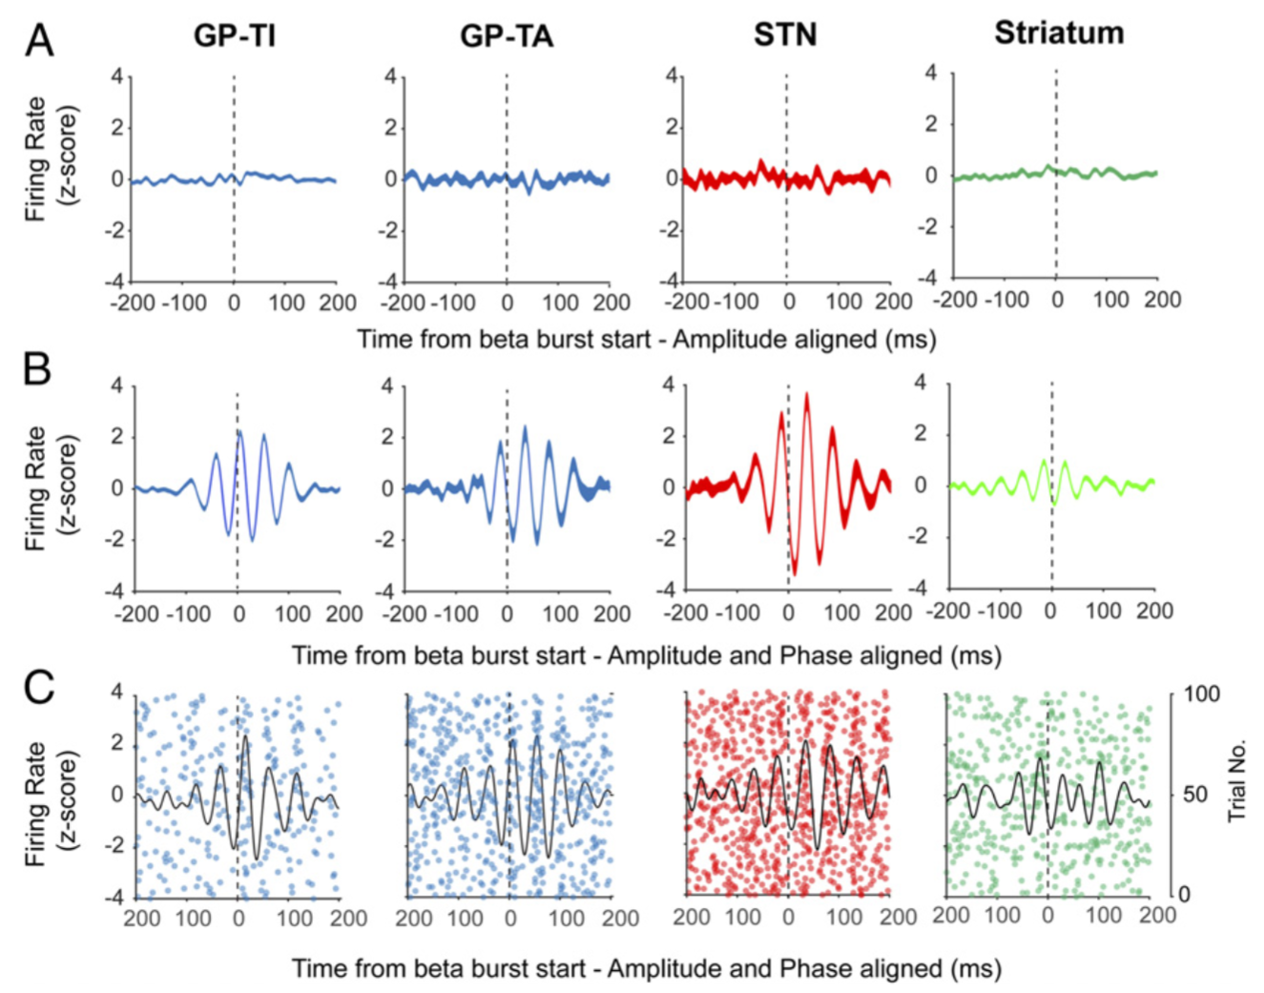
Notes:
Type-A GP neurons (GP-TA) were statistically defined as those preferentially discharging during the active component of the slow oscillation in ECoGs, whereas Type-I GP neurons (GP-TI) preferentially discharged during the inactive component
very low firing rate of SPNs (striatal neurons) under heathy conditions means that the tonic, background increase in iSPN excitability following dopamine depletion could still be crucial for these neurons to propagate cortical oscillations downstream (12). In contrast, in STN and GPe, much of the firing is driven by intrinsic currents (32). As a result, small perturbations to timing and synchronization of spiking can have a bigger impact on output than changes in excitability
Fig. 4. Basal ganglia units transiently phase lock to ECoG β bursts without modulation of firing rate. (A) Mean z-score firing rate of the burst onset-triggered (time 0, 75th percentile of amplitude) single units in each structure, with no adjustment for the cortical beta phase. Firing rate is not altered during the burst. (B) The same analysis but the burst onset trigger is shifted to the nearest peak in the cortical beta phase, aligning the phase of each burst around the trigger. Firing rate is significantly modulated by the phase alignment to the cortical oscillation and offset with respect to time 0. Numbers of units were the same for both analyses (GP-TI = 179, GP-TA = 40, STN = 18, Str = 104). (C) Representative examples of unit activity from the Str, GP-TA, GP-TI, and STN. Each subpanel shows spike timings derived from a single unit, across individual cortical bursts. Black lines indicate the corresponding averaged activity for that unit realigned to the time point that cortical beta amplitude crossed median levels.

Slide 13
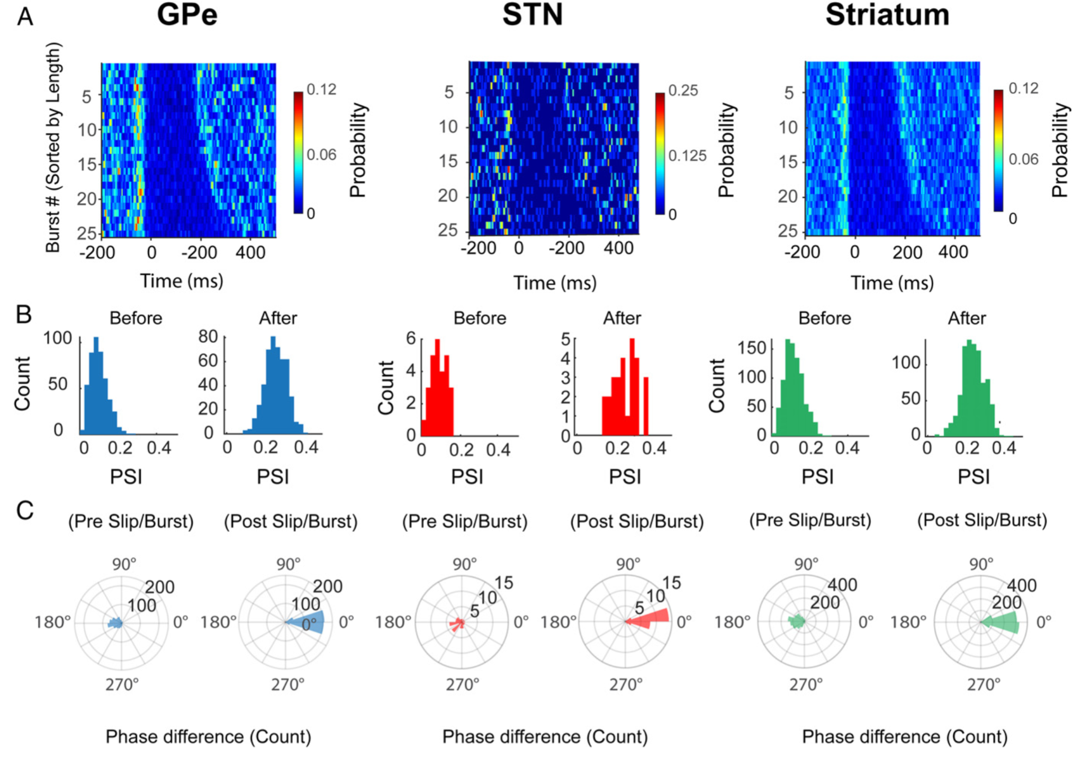
Notes:
„phase slips, defined here as abrupt changes in the phase difference of the ECoGβ and basal ganglia BUAβ phase, in relation to the ECoG β-burst onset“ (Cagnan et al., 2019, p. 16098)
„The average probability of a phase slip“ (Cagnan et al., 2019, p. 16098)
Fig. 3. Phase slips indicate that conditions for cortical and basal ganglia phase locking have been established before the onset of ECoG β bursts. (A) Average phase slips observed during the 25 longest ECoG β bursts in each recording. The phase alignment between the ECoGβ and BUAβ altered before the cortical burst onset (time = 0), defined according to the threshold crossing. (B) Phase alignment between the ECoG and the basal ganglia BUAβ, before a phase slip, was not consistent across different epochs, highlighted by low PSI values. After phase slip, phase alignment was around twice as consistent across different trials. (C) Phase alignment immediately before a phase slip differed from the phase alignment observed during the ECoG β burst. However, immediately after a phase slip, the phase alignment between signals was the same as the phase alignment observed during the ECoG β burst (i.e., 0° difference between the phase of alignment after the slip and during the burst). (In B and C, GPe = 366, STN = 22, and Str = 209 BUA signals.)

Slide 14
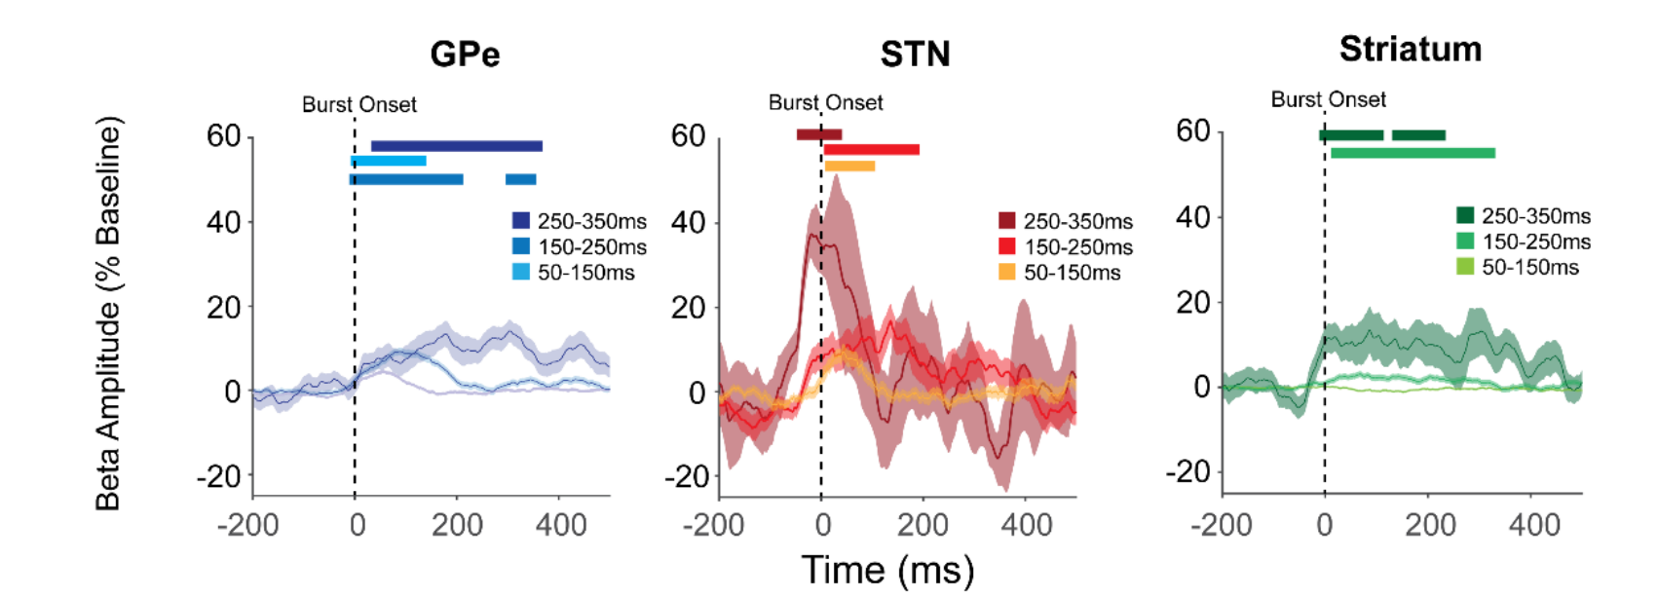
Notes:
Figure S5. GPe, STN and striatum BUAβ amplitude exhibits enhanced oscillatory activity in the beta frequency band during ECoG β-bursts. The amplitude envelope of the beta-filtered BUA activity from the basal ganglia aligned to the ECoG β-burst onset, defined according to the 75th percentile crossing. Significant increases with respect to baseline are indicated with horizontal bars, color matched to the burst duration. Significance for each burst length was determined using a cluster-based analysis (see Methods) which tested the difference of the modulation of BUAβ amplitude over time in the real data to that in randomly selected data with no relationship to burst onset. Significant increases with respect to baseline are indicated with horizontal bars, color matched to the burst duration. (Shaded regions indicate the standard error of the mean across all recordings made from a given structure)

Slide 15
take home
Cortico-subthalamic synchronization in patients with PD occurs before the onset and continues throughout the duration of beta bursts (also true for ECoG)
Basal ganglia and cortical synchrony for beta-oscillations were not affected by changes in firing rate but by the timing of action potentials (Phase)
A modulation of excitability is necessary to propagate cortical rhythms

Slide 16
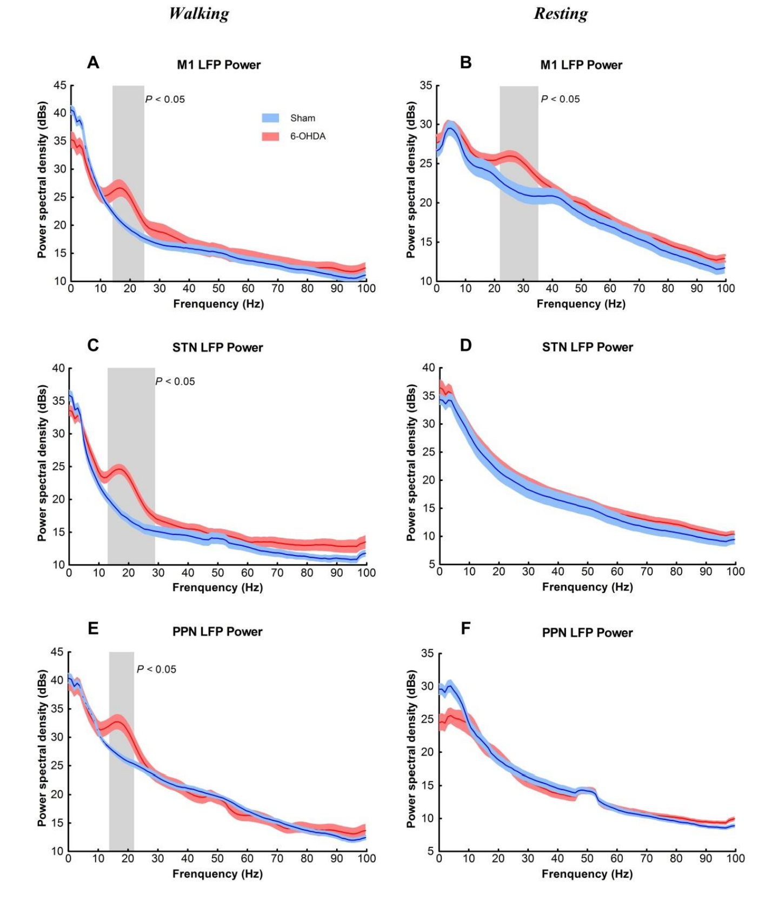
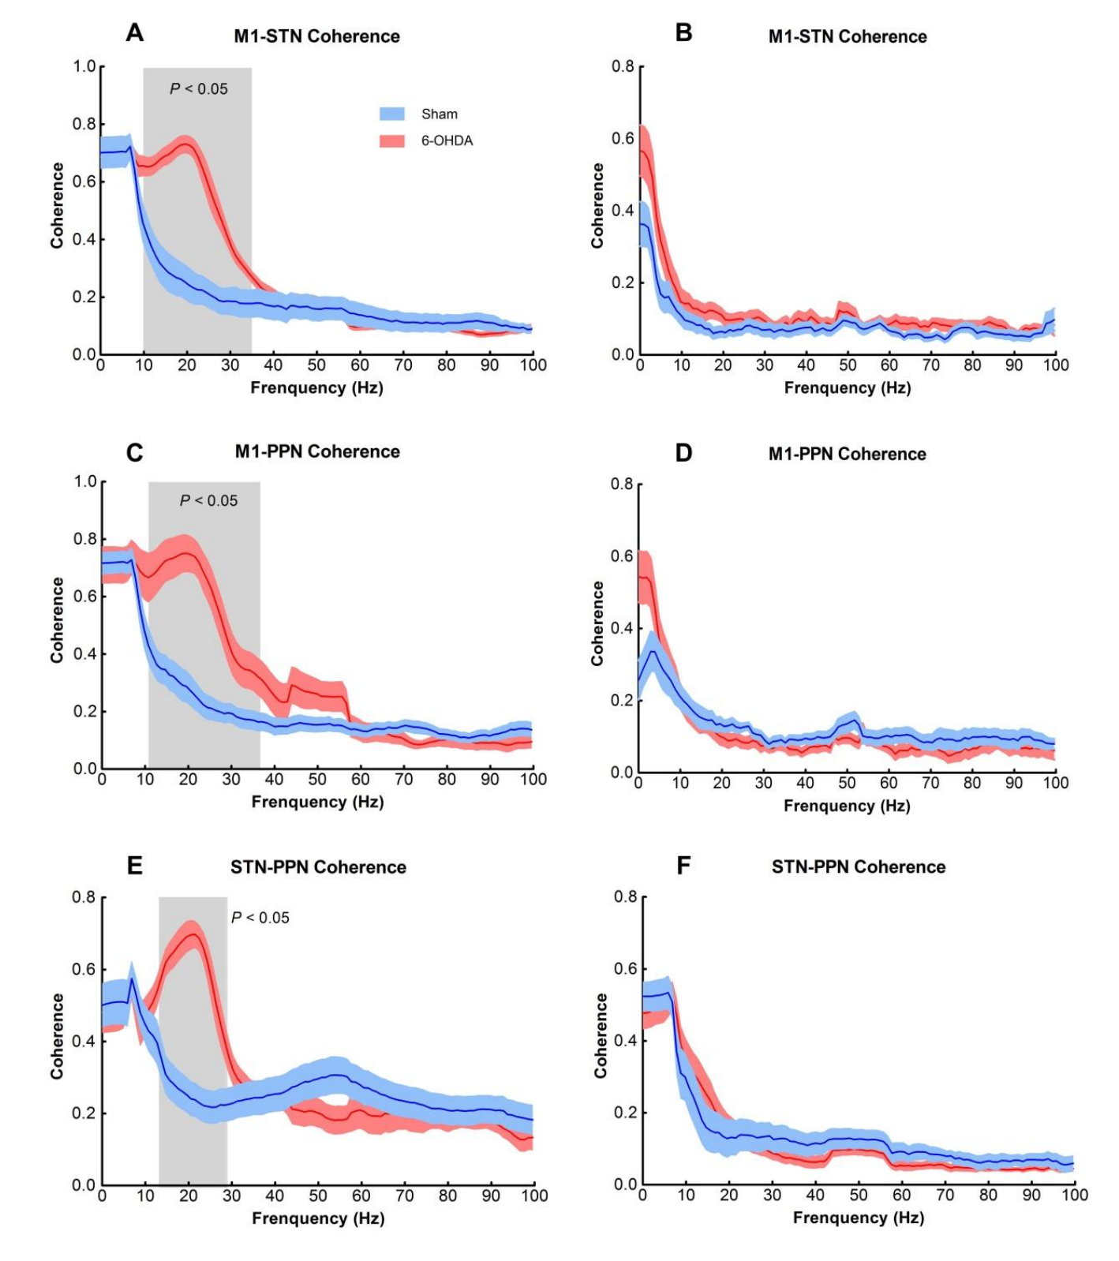
relevant for gait?
Li ea., Experimental Neurology, 2016
Notes:
PPN = pedunculopontine nucleus (brainstem)
Figure 3. Power spectral density of LFPs recorded in the M1, STN, and PPN. (A, C, E) During walking, power in the beta band was significantly increased in M1 (15–24 Hz), STN (13–28 Hz), and PPN (14–22 Hz) of 6-OHDA lesion rats (red) compared with sham lesion rats (blue). (B, D, F) During resting, power was significantly increased in M1 (21–35 Hz) in 6-OHDA lesion rats (B); no group differences were observed in STN (D) or PPN (F). Data are presented as mean ± standard error of the mean (SEM). The shaded area depicts the
Figure 4. Coherence between each pair of the three regions (M1, STN, and PPN) during walking and resting. (A, C, E) During walking, coherences of M1-STN, M1-PPN, and STN-PPN were increased in the frequency ranges of 10–34 Hz, 11–36 Hz, and 14–28 Hz, respectively, in 6-OHDA lesion rats (red) compared with sham lesion rats (blue). (B, D, F) During resting, there were no group differences. Data are depicted as means ± SEM. The shaded area depicts the frequency range of significant group differences.

Slide 17

Thanks for listening carefully

Slide 18
discussion
We know now, that in human PD patients beta bursts are temporally synchronised between the BG and Cortex. Which information do they exchange?
Some studies suggest that excessive beta oscillations may interfere with movement execution, while others propose that beta oscillations may help to stabilize movement or prevent unwanted movements. How much beta do you need?
A PD patient walks for 4 meters before being perturbated. What do you think does the probability course of beta bursts look like in M1?
How does training effect the number, duration and amplitude of beta bursts in PD patients?

Slide 19
Next JC
Next journal club:
19.04.23, 10am (UTC+1)
Topics: Cortex during gait, …
Slides and code
https://github.com/JuliusWelzel/StepUp-jc

Slide 20
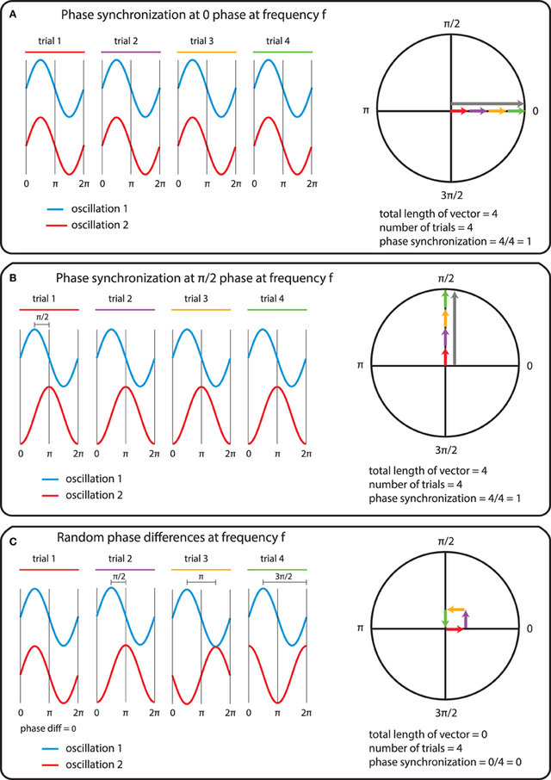
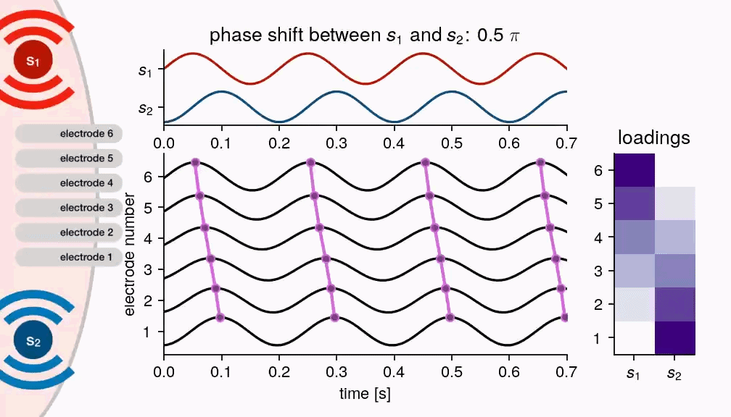
what is phase
Bastos, Frontiers in Systems Neuroscience, 2016; @nschawor

Slide 21
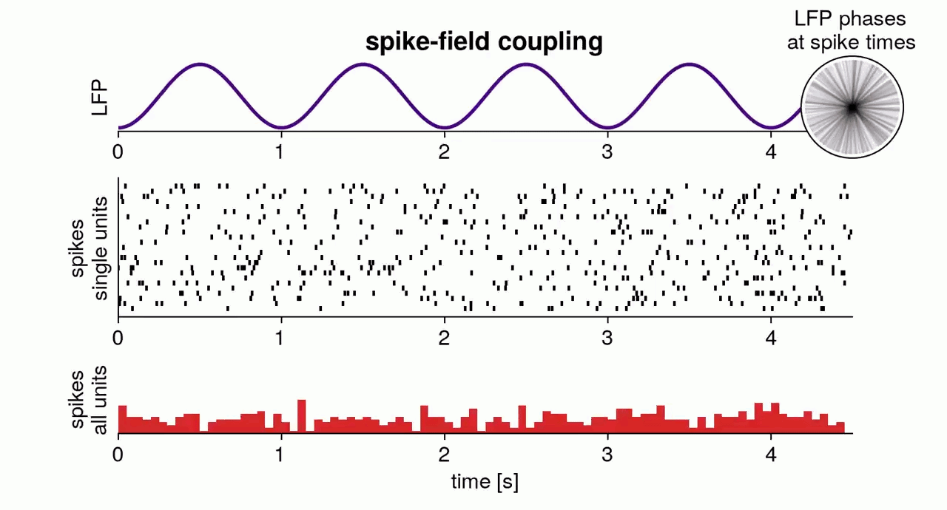
lfp and spikes

Slide 22
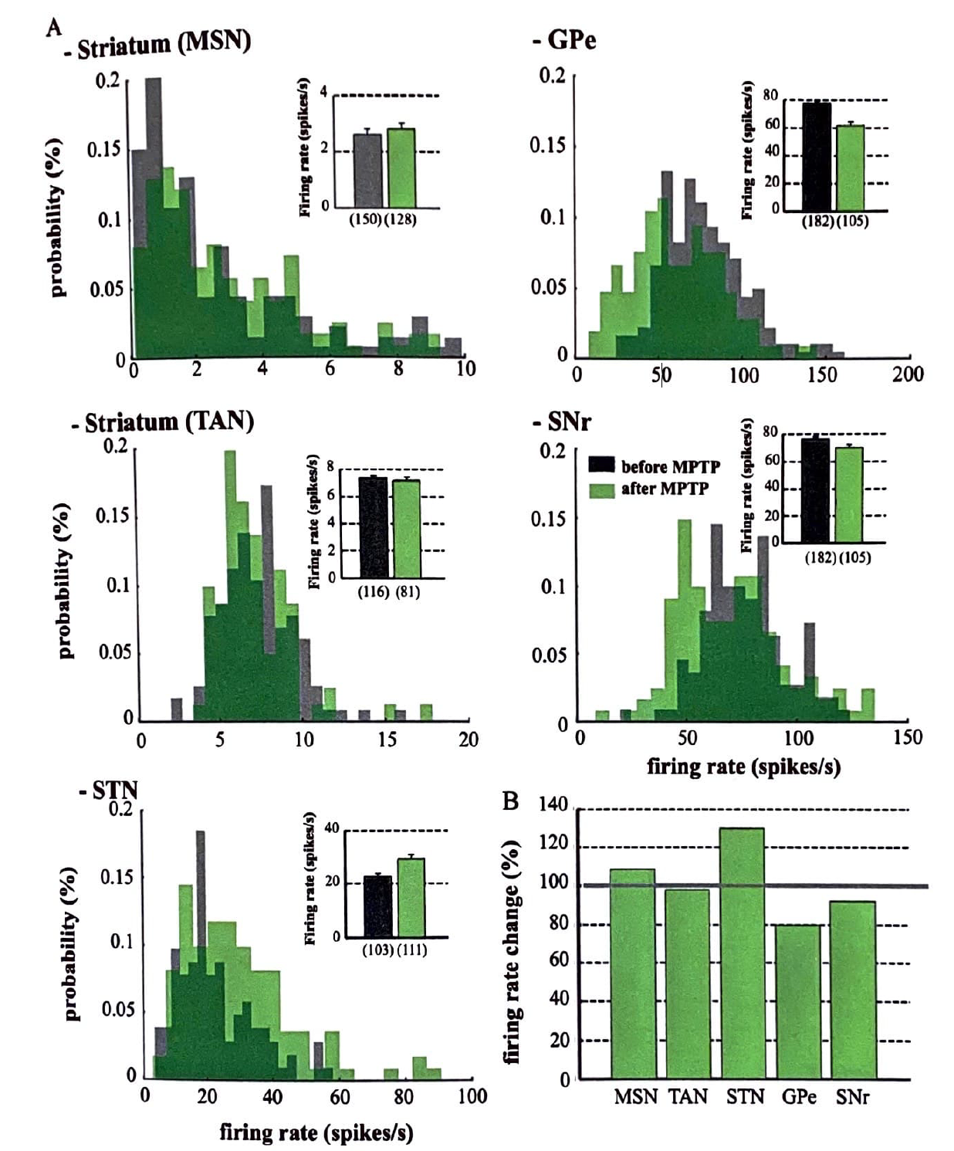
firing and PD
Hidden life of the basal ganglia
Notes:
15·2 Discharge-rate distribution in the basal ganglia before and after MPTP. A, distribution of distharge
rate in the striatum of MSNs, TANs, STN, GPe, and SNr before (contro·1, gray) and after (green)
MPTP treatment. lnset, mean discharge rate. B, relative changes to control. MSNs, medium spiny neurons;
TANs, tonically active neurons; STN, subthalamic nucleus; GPe, globus pallidus external segment;
SNr subst - ' antia nigra reticulata

